Slide 1
“Everything You Wanted to Know about Dominance,
But Were Afraid to Ask”

Slide 2
Wisconsin/UPMI
Fall Assembly Workshop on
Dominance
September 16, 2017

Slide 3
Dominance
Who can be dominant?
What does it look like?
Where do we see it?
When do we see it?
What do I do about it?
Notes:
We will work through these questions on dominance using the Knowledge Based Decision Making questions. I hope you will have a better understanding of what to do when you encounter dominance.

Slide 4
The Twelve Steps suggest acceptance of four primary ideas page 23 Groups at Work
We are Powerless Over the Problem of Alcoholism
We Can Turn Our Lives Over to a Power Greater Than Ourselves
We Need to Change Both Our Attitude and Our Actions
We Keep Al-Anon’s Gifts by Sharing Them With Others
Notes:
Al-Anon’s gifts need to be shared and practiced, or we will lose them. We need to constantly remember when we were newcomers and how it felt when Al-Anon’s gifts were shared with us.

Slide 5
Three Obstacles to Success in Al-Anon
Service Manual page 24
Discussions of Religion
Gossip
Dominance

Slide 6
Dominance:
Our leaders are trusted servants; they do not govern. No member of Al-Anon should direct, assume authority, or give advice. Our program is based on suggestion, interchange of experience, and rotation of leadership. We progress in our own way and pace. Any attempt to manage or direct is likely to have disastrous consequences for group harmony. Service Manual Page 24
Notes:
This is what our Service Manual says about dominance under the “Three Obstacles to Success in Al-Anon”. Is this only for the group leaders, or does this apply to all leadership in Al-Anon? Your elected Delegate is your Group voice at the World Service Conference, allowing the ultimate authority of the Groups?

Slide 7
Participation of members in group activities is important. This creates real involvement with the group and solidifies the relationship of individual member to the group. Since each group has only a limited number of officers, it’s best to have a policy of rotation, rather that have one member hold office for long periods of time. The more jobs available, the more members will participate and feel themselves to be an integral and important part of the group. Concept Four reminds us that “Participation is the key to harmony”.
Service Manual page 55
Notes:
The Service Manuel doesn’t say much on Dominance, but our literature has many examples. When someone is dominating, they are taking away a very valuable gift from the membership.

Slide 8
“Paths to Recovery”
Members accustomed to dominating may be unhappy when reminded that we rotate leaders and that we are to serve, not govern. Page 146
Rotating service in a group is very important for two reasons: 1) giving everyone an opportunity to serve, 2) keeping the person serving from feeling self-important. Page 150
Notes:
We do not like conflict, so a gentle reminder is best. If the person continues with dominance, a group conscience may be called.

Slide 9
“How Al-Anon Works”
We are all experts because of our experience, and we are all beginners because our lives are in a constant state of growth and change. Newcomers are as likely as longtime members to utter words that inspire and inform. So we have no reason to look to any one person or small group of people as authorities. Page 108
Notes:
We are all on our own journey in the program, no one reaches the end. We are always working to better ourselves. There are no graduates.

Slide 10
“How Al-Anon Works”
Just as Concept Three encourages mutual trust, Concept Four concerns mutual respect. When we honestly respect ourselves and those around us, we begin to look at everyone as equals, not as our inferiors or superiors. Without this respect, participation can be the key to chaos. Page 132
Notes:
Here Concept 3 & 4 talk about mutual trust and respect for all members, including ourselves.

Slide 11
“Many Voices, One Journey”
From the first “Family Group Forum in 1959”. “We have one member, perfectly sincere and all that, but who practically takes over our meetings whenever a question is asked. She acts as an automatic answering service. Answers usually are pretty good but it would be better if others, not so quick on their feet, were given more of a chance to get into the act. How can this be managed without offending our eager beaver?” Page 66
Notes:
Dominance isn’t anything new. Here a member from 1959 asked about a dominant member.

Slide 12
Al-Anon’s Twelve Steps & Twelve Traditions
Our leaders are those who are willing to be servants, those who devote their time, work and love to the fellowship. They have dedicated themselves to serving, not directing or controlling. Page 93
Notes:
Al-Anon’s leaders are servants. Anyone seeing themselves as “Having more experience” or making a statement like “Group Representatives don’t step up so I need to” may be causing harm within the fellowship.

Slide 13
It is an interesting Paradox that those Al-Anon members who have studied our program in depth, and practice it most faithfully in their daily lives, are the “trusted servants” who have come to realize the spiritual essance of Tradition Two.
Using this principle helps the group when an occasional member knows all the answers and tries to control the group or make independent decisions for it. Such a person may be motivated by good intentions, but behind it there is always the thought: “I know what’s best.” When an individual member assumes such authority, he or she prevents the others from participation that is so vital to everyone’s growth. Page 95
Notes:
Most of us in service work remember how much we have grown while doing service work. We need to pass on this experience, strength and hope for the growth of all in Al-Anon and Alateen.

Slide 14
Alateen – a Day at a Time
Some people are leaders, but no one has the right to take over God’s territory. The only way an Alateen group can keep going is if everyone has the chance to share their feelings and ideas. Tradition Two can make it happen that way in our group if we get to work and apply it. Page 56
Notes:
I love working with Alateens, they get right to the point

Slide 15
Alateen – a Day at a Time
Group problems need group answers. One person can’t decide what’s best for the group; we all need to get involved. When we all help to solve problems, everybody has a chance to grow. That’s the group conscience at work – the way God wants it to be. Page 167
Notes:
We have looked at many examples of dominance from the Service Manual and our literature. Most examples talk about “groups”, but groups can also be groups such as your home meeting group, your District group, your AWSC group, your Assembly group, your Regional Delegates Meeting group, and your World Service Conference group.

Slide 16
KBDM
Knowledge
Based
Decision
Making
Notes:
Let’s refresh ourselves on Knowledge Based Decision Making. Most of the following is from an online workshop on KBDM.

Slide 17
KBDM four elements
Open communication between leadership and membership
All decision makers have common access to full information
Dialogue before deliberation
We exist in a culture of trust
Notes:
These four elements are very important when working through KBDM, if one is not present the process will be very difficult and may affect the results.

Slide 18
Question One
What do we currently know about our members’
or prospective members’ needs that is relevant to this discussion?
Or,
What do we know about what our members need and want?
Notes:
I like that the second question in each panel is an easily understandable paraphrase of the original question.

Slide 19
Question Two
What do we know about the resources and our vision for the organization that is relevant to this discussion?
Or,
What do we know about our resources and capability?
Notes:
With question two, we may need to focus on the original question “vision for the organization”.

Slide 20
Question Three
What do we know about the current realities and our fellowship that is relevant to this discussion? (What are the Pros and Cons?)
Or,
What do we know about what’s currently happening within our groups?
Notes:
Pros and Cons of dominance? Yes, there are some Pros, but are they healthy?

Slide 21
Question Four
What are the ethical implications of our choices?
Or,
Will our decision be consistent with our spiritual principles?
Notes:
Here the second question fits for me, but either will work.

Slide 22
Question Five
What do we wish we knew, but don’t?
Or,
What else do we need to know before moving forward?
Notes:
Question Five is used the most, but is the most confusing to me. If I don’t know it, how would I wish I did know, what I don’t know? I like the paraphrased question better.

Slide 23

Sunny without any Dominance
Notes:
Virginia Beach from my hotel room, early morning.

Slide 24
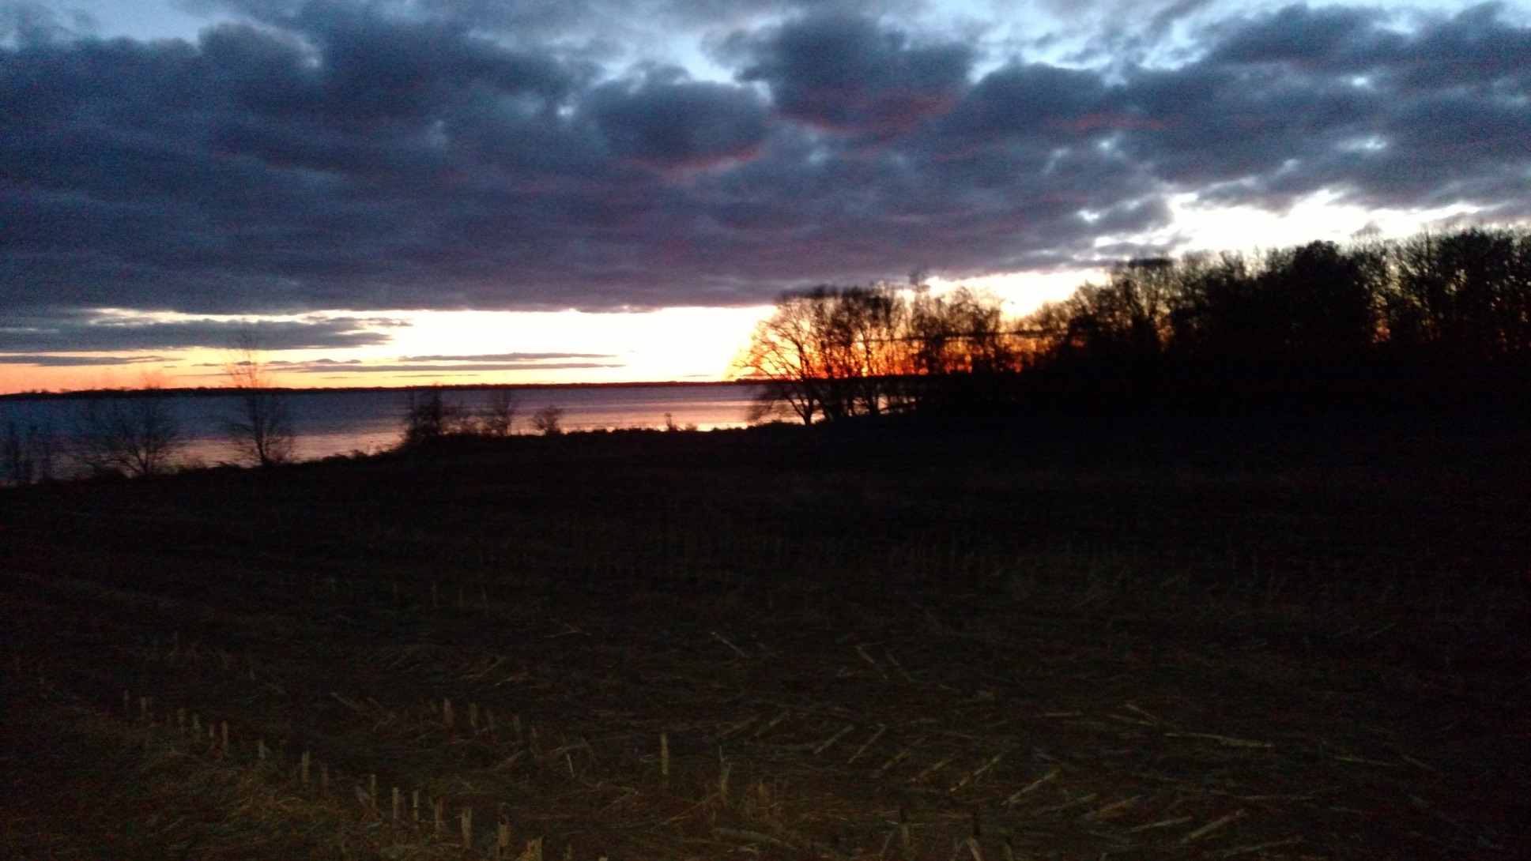
Rough path with Dominance
Notes:
Tripping over corn stalk stubble and plowed fields coming out of my hunting blind. The last 17 years I’ve been just watching the deer, but don’t tell my hunting friends.

Slide 25
KBDM on Dominance
15 min group discussion
2 min group report back
Questions & Comments
Notes:
I will have a paper copy of this entire power point on each table for reference during your group discussion. This power point will also be posted on our Area 61 website. Let’s get started. Using the Knowledge Based Decision Making questions, let’s answer the five dominance questions, who, what, where, when and the most important, what do I do about it?

